Slide 1
Tic-Tac-Toe
Robert Nadrich

Slide 2
Brief History
An early variant of Tic-tac-toe was played in the Roman Empire, around the first century BC, but in this version each player had only exactly three pieces. They needed to move the pieces around to form three in a row.
The first print reference to "Noughts and crosses", the British name, appeared in 1864. The first print reference to a game called "tick-tack-toe" occurred in 1884

Slide 3
Brief History Continued
The U.S. renaming of Noughts and crosses as Tic-tac-toe occurred in the 20th century
In 1952, Tic-Tac-Toe became one of the first known video games. The computer player could play perfect games of Tic-tac-toe against a human opponent.

Slide 4
How to play?
Tic-Tac-Toe the objective is to get three of your symbols in a row before your opponent, but if the board is full with no player reaching three in a row you tie.
The players choose where to place there symbols on a 3x3 board, each player can not move into a space that is already occupied

Slide 5
AI implementations
Random behavior
Search Techniques
Expert Systems

Slide 6
Random Behavior
When using Random Behavior the computer will move in a Random Pattern
This will be our beginner level in Tic-Tac-Toe
The computer will choose a random position on the board. If the computer can not move to that position it will continually choose positions at random till it can move.

Slide 7
Random Behavior Continued
In order to solve for the computers random behavior:
The computer will compute a random row and column position that is on the board
Then the computer will check to see if it can move into that position.
It will repeat until it can finally move, then will wait for the players turn and continue until the game is over

Slide 8
Search Techniques
With search techniques the computer will be more advanced and aware of what is going on in the game.
This will be our intermediate level.
Using a search technique the computer will be able to determine if it is about to win or is about to lose.

Slide 9
Search Techniques Continued
In order for the computer to know if it is about to win or lose the computer must search for two in a row and determine if it is possible to make three in a row.
In order to implement this technique the computer will survey the board starting from the top left corner, check the row and column. After it has checked every move possible from that position it will move to the next location and repeat until it gets all the information.

Slide 10
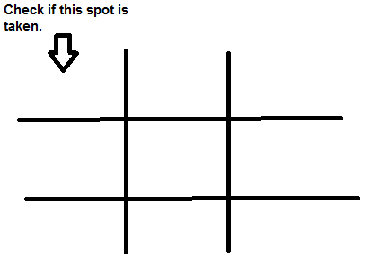
Search Techniques Continued

Slide 11
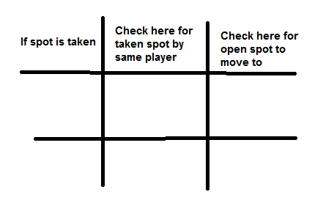
Search Techniques Continued

Slide 12
Search Techniques continued
With this search technique we can create a state space model.
Using this model the computer can create a heuristic evaluation as to which move is the most important to make.

Slide 13
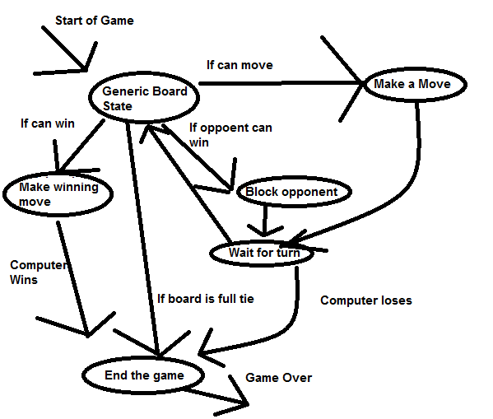
Search Techniques Continued
State Space representation

Slide 14
Search Techniques Continued
With this model the heuristic evaluation from most to least of importance:
  Win if can win
  Block if opponent can win
  Make a move
  Wait for turn
In the generic board state is where the computer gathers all the information about the board. (ie. If the player has two in a row)

Slide 15
Expert systems
With Expert Systems we inject the computer a set of rules.
This is the Expert mode
With these rules the computer will know how to react to a given situation

Slide 16
Expert Systems Continued
The rules that are defined for Tic-Tac-Toe:
  If the computer can win, then win
  If the computer is about to lose, then block
  If the computer can take a corner, take a corner
  If the computer can take the center, take center
  If the computer can take a side, take a side

Slide 17
Expert Systems Continued
With these rules, the computer can us the best strategy to beat its opponent or prevent the opponent from winning.
For example, if the opponent makes the first move in the center the computer takes the corner.

Slide 18
Expert Systems Continued
With expert systems the computer will analyze each situation and determine the best possible move based on the rules it has been given.
With the Expert Systems, the computer has a very predictable pattern.
The opponent can recognize these patterns and develop a strategy to prevent the computer from winning.

